Slide 1
The English Alphabet 𐑞 𐑦𐑙𐑜𐑤𐑦𐑖 𐑨𐑤𐑓𐑩𐑚𐑧𐑑
What’s wrong with it & how fix it. 𐑢𐑪𐑑𐑕 𐑮𐑪𐑙 𐑢𐑦𐑞 𐑦𐑑 𐑯 𐑣𐑬 𐑑 𐑓𐑦𐑒𐑕 𐑦𐑑.

Slide 2
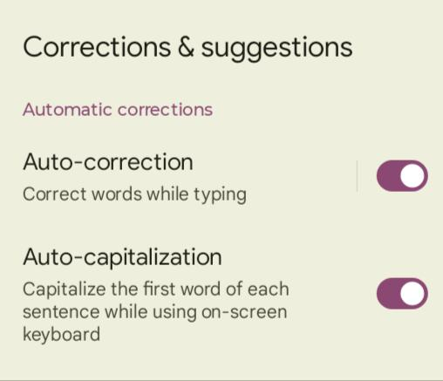
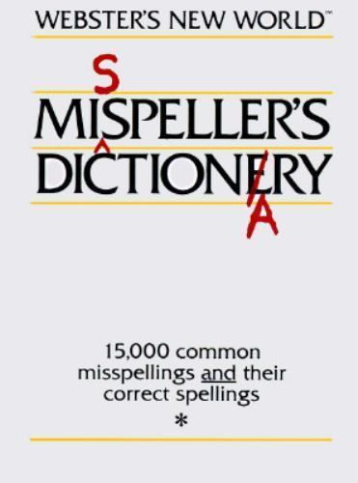
Spelling Help
Autocorrect (1993)
Spell check (1980)
Misspeller’s Dictionary (1974)

Slide 3
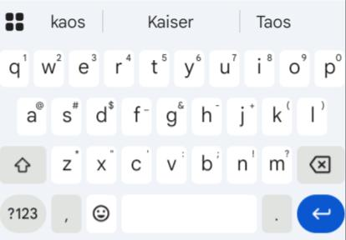
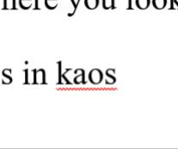
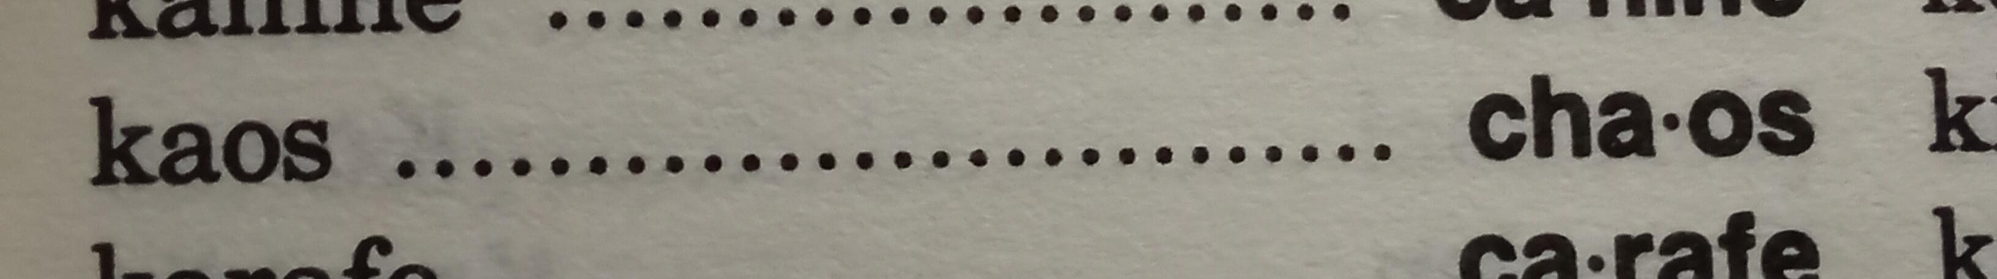
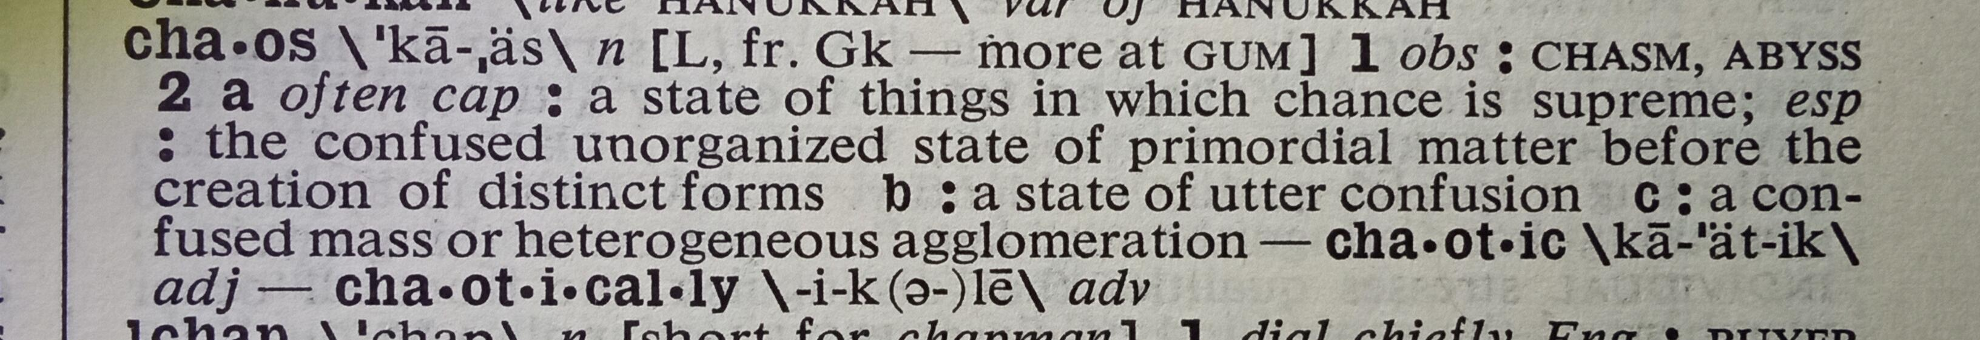
Spelling Help
Autocorrect, spell check, and misspeller’s dictionaries help correct spelling
Dictionaries define meaning of words

Slide 4
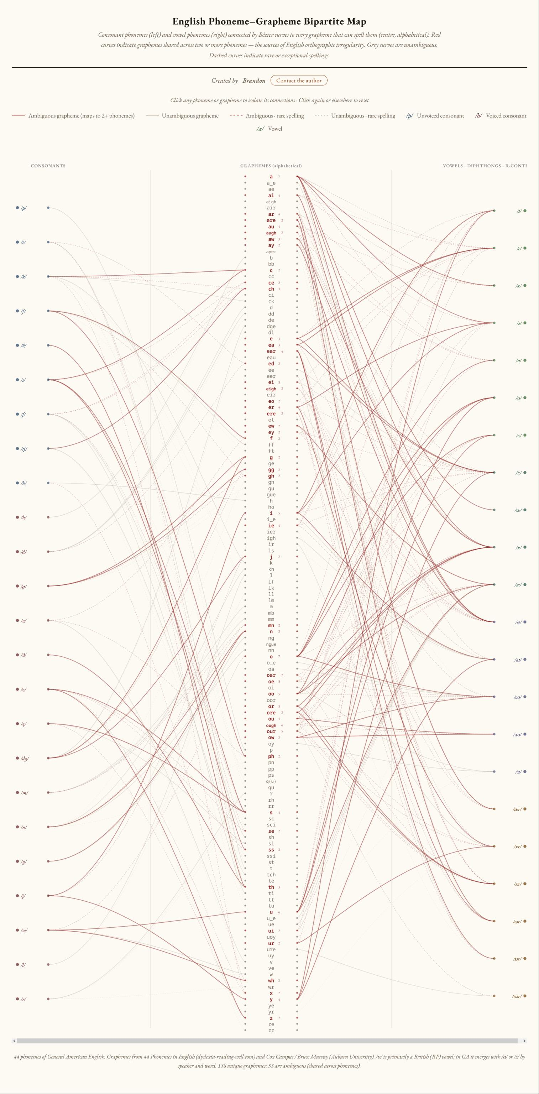
Why is spelling difficult?
21 consonant letters for 24 consonant sounds
5 vowel letters for 16 vowel sounds
1,000 years of spelling history makes 138+ letter combinations for 53 sounds

Slide 5
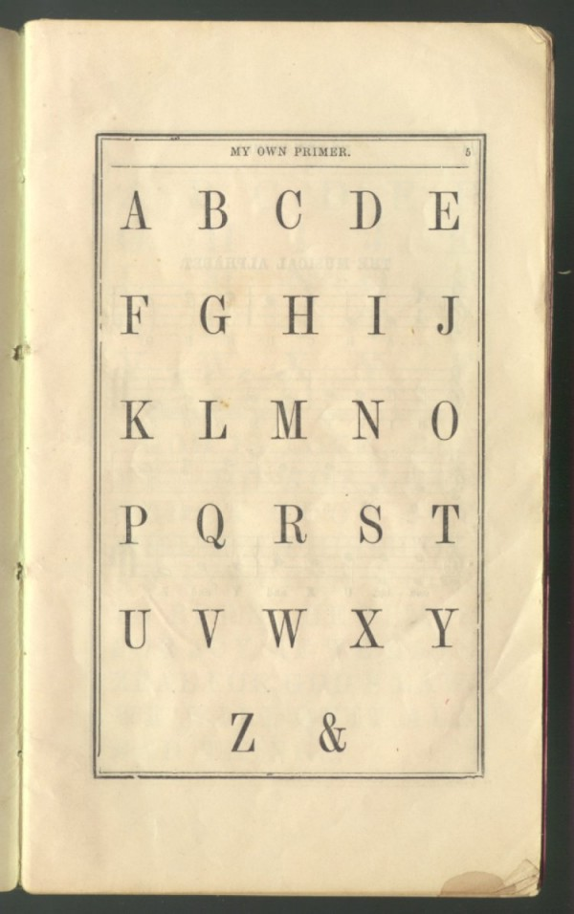
Why is spelling difficult?
Part of the reason for complex spelling is that the alphabet has changed.
For example, in the 1800s, the alphabet included “&.”
Notes:
Source: https://en.wikipedia.org/wiki/Ampersand

Slide 6
The Alphabet
1800s
A B C D E F G H I J K L M N O P Q R S T U V W X Y Z &
1700s – the Long-S – “Congress” is spelled “Congreſs.”
1600s
A B C D E F G H I K L M N O P Q R S T V W X Y Z
Without J or U, “Jesus” is spelled “Iesvs.”
Previous alphabets had no J, U, or W
but included ʒ, æ, þ, ð, ƿ, œ, and ⁊ at various times.

Slide 7
Pronunciation
Today – The night was dark.
1650 – The night was darke.
1380 – þe niʒt vvas derke·
1000 – seo niht ƿæs þeostru·
650 – ᛋᛖᚩ᛫ᚾᛁᚻᛏ᛫ᚹᛇᛋ᛫ᚦᛖᚩᛋᛏᚱᚢ
nict → nykt → nite

Slide 8
Pronunciation
ᚾᛁᚻᛏ → niht → niʒt → night
Futhorc runes were replaced by the Latin alphabet.
NIHT represents the pronunciation
NIƷT is sometimes spelled ‘nyghte’
NIGHT is for the old pronunciation

Slide 9
Spelling = Pronunciation
Spelled: The night was dark.
Pronounced: \t͟hə ˈnīt ˈwəz ˈdärk\
One way to make spelling reflect pronunciation is to simplify spelling rules.
This is called spelling reform.
Ex. Soundspel: Th niet wuz dark.

Slide 10
Spelling = Pronunciation
Problem with spelling reform: still trying to make 26 letters represent 40 or more sounds.
Alphabet reform: adds letters to better match sounds.
Franklin alphabet: ɧi nɥit uoɑz dɑ̂rk.
Deseret alphabet: 𐐜 𐑌𐐴𐐻 𐐶𐐱𐑆 𐐼𐐪𐑉𐐿.
Shavian alphabet: 𐑞 𐑯𐑲𐑑 𐑢𐑪𐑟 𐑛𐑸𐑒.

Slide 11
Spelling = Pronunciation
Franklin alphabet: o ɑ a e i u ɥ h g k ʃ ŋ n r t d l ħ dh s z f v b p m
Deseret alphabet: 𐐀 𐐁 𐐂 𐐃 𐐄 𐐅 𐐆 𐐇 𐐈 𐐉 𐐊 𐐋 𐐌 𐐍 𐐎 𐐏 𐐐 𐐑 𐐒 𐐓 𐐔 𐐕 𐐖 𐐗 𐐘 𐐙 𐐚 𐐛 𐐜 𐐝 𐐞 𐐟 𐐠 𐐡 𐐢 𐐣 𐐤 𐐥
Shavian alphabet: 𐑐 𐑚 𐑑 𐑛 𐑒 𐑜 𐑓 𐑝 𐑔 𐑞 𐑕 𐑟 𐑖 𐑠 𐑗 𐑡 𐑘 𐑢 𐑙 𐑣 𐑤 𐑮 𐑥 𐑯 𐑦 𐑰 𐑧 𐑱 𐑨 𐑲 𐑩 𐑳 𐑪 𐑴 𐑫 𐑵 𐑬 𐑶 𐑭 𐑷 𐑸 𐑹 𐑺 𐑻 𐑼 𐑽 𐑾 𐑿

Slide 12
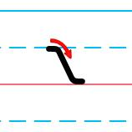
Let’s fix it!
Since the last letter removed from the alphabet was ‘&,’ why don’t we make it the first one back in?
This is ‘nun.’ It stands for ‘and.’ Think of it like bread ‘n’ butter.

Slide 13
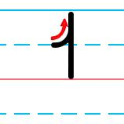
Let’s fix it!
This is the letter ‘tot.’ It often stands for the word ‘to.’
Think of to and from. Do NOT use ‘tot’ for the number ‘two’ or ‘too’ as in ‘also.’

Slide 14
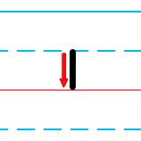
Let’s fix it!
and → 𐑯
to → 𐑑
in → 𐑦𐑯
it → 𐑦𐑑
This is the letter ‘if,’ but does NOT stand for the word ‘if.’

Slide 15
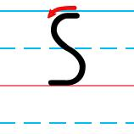
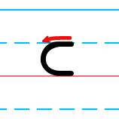
Let’s fix it!
Here’s are the letters ‘so’ and ‘loll.’ They’re used in the word ‘still,’
as in 𐑕𐑑𐑦𐑤.
Even though ‘so’ looks like an ‘S,’ and it makes one of the ‘S’ sounds, it’s better to think of it as ‘so’ and a new letter with new rules.
Notes:
From “Man Of Steel,” there’s a quote, “It’s not an ‘S’.”

Slide 16
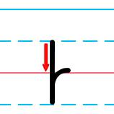
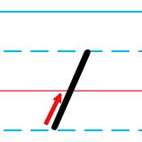
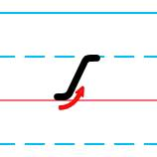
Let’s fix it!
You can’t spell ‘did’ without the letter ‘dead.’ ‘Did’ is spelled 𐑛𐑦𐑛.
The letter ‘woe’ starts the word ‘will.’ It’s spelled 𐑢𐑦𐑤.
‘Mum’ is the letter you need to spell ‘women’ → 𐑢𐑦𐑥𐑦𐑯. Notice how 𐑢𐑦𐑥𐑦𐑯 is spelled like it sounds.

Slide 17
Review
𐑯 nun – 𐑯 (and)
𐑑 tot – 𐑑 (to)
𐑦 if – 𐑦𐑯 (in), 𐑦𐑑 (it)
𐑕 so
𐑤 loll – 𐑕𐑑𐑦𐑤 (still)
𐑛 dead – 𐑛𐑦𐑛 (did)
𐑢 woe – 𐑢𐑦𐑤 (will)
𐑥 mum – 𐑢𐑦𐑥𐑦𐑯 (women)

Slide 18
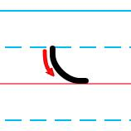
𐑧 – egg
men → 𐑥𐑧𐑯
said → 𐑕𐑧𐑛
well → 𐑢𐑧𐑤
went → 𐑢𐑧𐑯𐑑
when → 𐑢𐑧𐑯

Slide 19
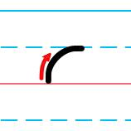
𐑩 – ado
a → 𐑩 an → 𐑩𐑯 didn’t → 𐑛𐑦𐑛𐑩𐑯𐑑 little → 𐑤𐑦𐑑𐑩𐑤 unless → 𐑩𐑯𐑤𐑧𐑕 until → 𐑩𐑯𐑑𐑦𐑤

Slide 20
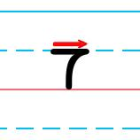
𐑳 – up
done → 𐑛𐑳𐑯
must → 𐑥𐑳𐑕𐑑
none → 𐑯𐑳𐑯
once → 𐑢𐑳𐑯𐑕
one → 𐑢𐑳𐑯
some → 𐑕𐑳𐑥
us → 𐑳𐑕

Slide 21
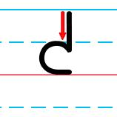
𐑒 – kick
come → 𐑒𐑳𐑥
next → 𐑯𐑧𐑒𐑕𐑑

Slide 22
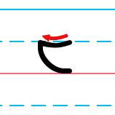
𐑱 – age
away → 𐑩𐑢𐑱
came → 𐑒𐑱𐑥
day → 𐑛𐑱
made → 𐑥𐑱𐑛
make → 𐑥𐑱𐑒
may → 𐑥𐑱
same → 𐑕𐑱𐑥
say → 𐑕𐑱
take → 𐑑𐑱𐑒
today → 𐑑𐑩𐑛𐑱
way → 𐑢𐑱

Slide 23
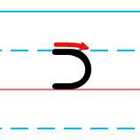
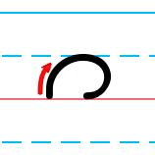
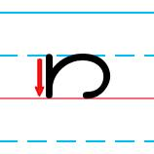
𐑮 – roar 𐑼 – array 𐑽 – ear
written → 𐑮𐑦𐑑𐑩𐑯
under → 𐑳𐑯𐑛𐑼
dear → 𐑛𐑽
near → 𐑯𐑽

Slide 24
Review 1
𐑯 nun – 𐑯 (and)
𐑑 tot – 𐑑 (to)
𐑦 if – 𐑦𐑯 (in), 𐑦𐑑 (it)
𐑕 so
𐑤 loll – 𐑕𐑑𐑦𐑤 (still)
𐑛 dead – 𐑛𐑦𐑛 (did)
𐑢 woe – 𐑢𐑦𐑤 (will)
𐑥 mum – 𐑢𐑦𐑥𐑦𐑯 (women)

Slide 25
Review 2
𐑧 egg – 𐑥𐑧𐑯 (men), 𐑕𐑧𐑛 (said), 𐑢𐑧𐑤 (well)
𐑩 ado – 𐑩 (a), 𐑛𐑦𐑛𐑩𐑯𐑑 (didn’t), 𐑤𐑦𐑑𐑩𐑤 (little)
𐑳 up – 𐑛𐑳𐑯 (done), 𐑢𐑳𐑯 (one)
𐑒 kick – 𐑒𐑳𐑥 (come), 𐑯𐑧𐑒𐑕𐑑 (next)
𐑱 age – 𐑥𐑱𐑒 (make), 𐑑𐑩𐑛𐑱 (today)
𐑮 roar – 𐑮𐑦𐑑𐑩𐑯 (written)
𐑼 array – 𐑳𐑯𐑛𐑼 (under)
𐑽 ear – 𐑛𐑽 (dear), 𐑯𐑽 (near)

Slide 26
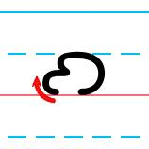
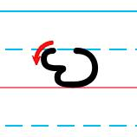
𐑺 – air 𐑻 – err
where → 𐑢𐑺
were → 𐑢𐑻 word → 𐑢𐑻𐑛 work → 𐑢𐑻𐑒 world → 𐑢𐑻𐑤

Slide 27
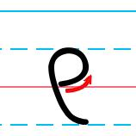
𐑞 – they
other → 𐑳𐑞𐑼
the → 𐑞
their → 𐑞𐑺
them → 𐑞𐑧𐑥
then → 𐑞𐑧𐑯
there → 𐑞𐑺
they → 𐑞𐑱
this → 𐑞𐑦𐑕
with → 𐑢𐑦𐑞

Slide 28
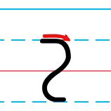
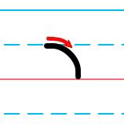
𐑟 – zoo 𐑪 – on
does → 𐑛𐑳𐑟
is → 𐑦𐑟
says → 𐑕𐑧𐑟
lost → 𐑤𐑪𐑕𐑑
not → 𐑯𐑪𐑑
on → 𐑪𐑯
want → 𐑢𐑪𐑯𐑑
was → 𐑢𐑪𐑟
wasn’t → 𐑢𐑪𐑟𐑩𐑯𐑑
what → 𐑢𐑪𐑑

Slide 29
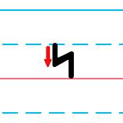
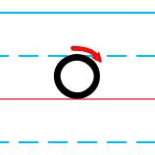
𐑰 – eat 𐑴 – oak
me → 𐑥𐑰
read → 𐑮𐑰𐑛
these → 𐑞𐑰𐑟
we → 𐑢𐑰
don’t → 𐑛𐑴𐑯𐑑
know → 𐑯𐑴
most → 𐑥𐑴𐑕𐑑
no → 𐑯𐑴
old → 𐑴𐑤𐑛
own → 𐑴𐑯
so → 𐑕𐑴
those → 𐑞𐑴𐑟

Slide 30
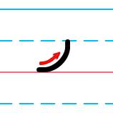
𐑨 – ash
am → 𐑨𐑥
as → 𐑨𐑟
at → 𐑨𐑑
can → 𐑒𐑨𐑯
cannot → 𐑒𐑨𐑯𐑪𐑑
man → 𐑥𐑨𐑯
than → 𐑞𐑨𐑯
that → 𐑞𐑨𐑑

Slide 31
Review 1
𐑯 nun – 𐑯 (and)
𐑑 tot – 𐑑 (to)
𐑦 if – 𐑦𐑯 (in), 𐑦𐑑 (it)
𐑕 so
𐑤 loll – 𐑕𐑑𐑦𐑤 (still)
𐑛 dead – 𐑛𐑦𐑛 (did)
𐑢 woe – 𐑢𐑦𐑤 (will)
𐑥 mum – 𐑢𐑦𐑥𐑦𐑯 (women)

Slide 32
Review 2
𐑧 egg – 𐑥𐑧𐑯 (men), 𐑕𐑧𐑛 (said), 𐑢𐑧𐑤 (well)
𐑩 ado – 𐑩 (a), 𐑛𐑦𐑛𐑩𐑯𐑑 (didn’t), 𐑤𐑦𐑑𐑩𐑤 (little)
𐑳 up – 𐑛𐑳𐑯 (done), 𐑢𐑳𐑯 (one)
𐑒 kick – 𐑒𐑳𐑥 (come), 𐑯𐑧𐑒𐑕𐑑 (next)
𐑱 age – 𐑥𐑱𐑒 (make), 𐑑𐑩𐑛𐑱 (today)
𐑮 roar – 𐑮𐑦𐑑𐑩𐑯 (written)
𐑼 array – 𐑳𐑯𐑛𐑼 (under)
𐑽 ear – 𐑛𐑽 (dear), 𐑯𐑽 (near)

Slide 33
Review 3
𐑺 air – 𐑢𐑺 (where)
𐑻 err – 𐑢𐑻 (were), 𐑢𐑻𐑤𐑛 (world)
𐑞 they – 𐑳𐑞𐑼 (other), 𐑞𐑧𐑯 (then)
𐑟 zoo – 𐑛𐑳𐑟 (does), 𐑦𐑟 (is), 𐑕𐑧𐑟 (says)
𐑪 on – 𐑤𐑪𐑕𐑑 (lost), 𐑯𐑪𐑑 (not), 𐑢𐑪𐑟 (was)
𐑰 eat – 𐑥𐑰 (me), 𐑮𐑰𐑛 (read), 𐑞𐑰𐑟 (these)
𐑴 oak – 𐑛𐑴𐑯𐑑 (don’t), 𐑯𐑴 (know)
𐑨 ash – 𐑨𐑥 (am), 𐑒𐑨𐑯 (can), 𐑞𐑨𐑑 (that)

Slide 34
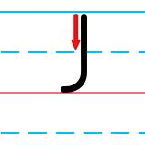
𐑓 – fee
enough → 𐑦𐑯𐑳𐑓
first → 𐑓𐑻𐑕𐑑
from → 𐑓𐑮𐑪𐑥
if → 𐑦𐑓
off → 𐑪𐑓
often → 𐑪𐑓𐑩𐑯, 𐑪𐑓𐑑𐑩𐑯

Slide 35
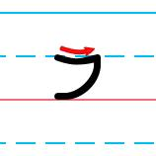
𐑲 – ice
either → 𐑲𐑞𐑼, 𐑰𐑞𐑼
I → 𐑲
like → 𐑤𐑲𐑒
might → 𐑥𐑲𐑑
my → 𐑥𐑲
quite → 𐑒𐑢𐑲𐑑
right → 𐑮𐑲𐑑
time → 𐑑𐑲𐑥
while → 𐑢𐑲𐑤
why → 𐑢𐑲
write → 𐑮𐑲𐑑

Slide 36
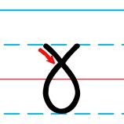
𐑣 – haha
had → 𐑣𐑨𐑛
has → 𐑣𐑨𐑟
he → 𐑣𐑰
her → 𐑣𐑻
here → 𐑣𐑽
him → 𐑣𐑦𐑥
his → 𐑣𐑦𐑟
whole → 𐑣𐑴𐑤

Slide 37
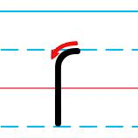
𐑝 – vow
ever → 𐑧𐑝𐑼
have → 𐑣𐑨𐑝
love → 𐑤𐑳𐑝
never → 𐑯𐑧𐑝𐑼
of → 𐑝
over → 𐑴𐑝𐑼

Slide 38
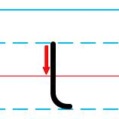
𐑚 – bib
be → 𐑚𐑰
because → 𐑚𐑦𐑒𐑪𐑟
been → 𐑚𐑰𐑯
between → 𐑚𐑦𐑑𐑢𐑰𐑯
business → 𐑚𐑦𐑟𐑯𐑩𐑕
but → 𐑚𐑳𐑑
by → 𐑚𐑲

Slide 39
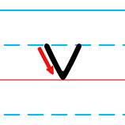
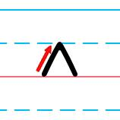
𐑫 – wool 𐑵 – ooze
could→ 𐑒𐑫𐑛
look → 𐑤𐑫𐑒
woman→ 𐑢𐑫𐑥𐑩𐑯
would → 𐑢𐑫𐑛
do → 𐑛𐑵
into → 𐑦𐑯𐑑𐑵
too → 𐑑𐑵
two → 𐑑𐑵
who → 𐑣𐑵
whose → 𐑣𐑵𐑟

Slide 40
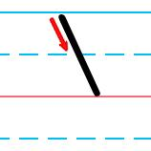
𐑘 – yea
year → 𐑘𐑽
yesterday → 𐑘𐑧𐑕𐑑𐑼𐑛𐑱
yet → 𐑘𐑧𐑑
your → 𐑘𐑫𐑼, 𐑘𐑹

Slide 41
Review 1
𐑯 nun – 𐑯 (and)
𐑑 tot – 𐑑 (to)
𐑦 if – 𐑦𐑯 (in), 𐑦𐑑 (it)
𐑕 so
𐑤 loll – 𐑕𐑑𐑦𐑤 (still)
𐑛 dead – 𐑛𐑦𐑛 (did)
𐑢 woe – 𐑢𐑦𐑤 (will)
𐑥 mum – 𐑢𐑦𐑥𐑦𐑯 (women)

Slide 42
Review 2
𐑧 egg – 𐑥𐑧𐑯 (men), 𐑕𐑧𐑛 (said), 𐑢𐑧𐑤 (well)
𐑩 ado – 𐑩 (a), 𐑛𐑦𐑛𐑩𐑯𐑑 (didn’t), 𐑤𐑦𐑑𐑩𐑤 (little)
𐑳 up – 𐑛𐑳𐑯 (done), 𐑢𐑳𐑯 (one)
𐑒 kick – 𐑒𐑳𐑥 (come), 𐑯𐑧𐑒𐑕𐑑 (next)
𐑱 age – 𐑥𐑱𐑒 (make), 𐑑𐑩𐑛𐑱 (today)
𐑮 roar – 𐑮𐑦𐑑𐑩𐑯 (written)
𐑼 array – 𐑳𐑯𐑛𐑼 (under)
𐑽 ear – 𐑛𐑽 (dear), 𐑯𐑽 (near)

Slide 43
Review 3
𐑺 air – 𐑢𐑺 (where)
𐑻 err – 𐑢𐑻 (were), 𐑢𐑻𐑤𐑛 (world)
𐑞 they – 𐑳𐑞𐑼 (other), 𐑞𐑧𐑯 (then)
𐑟 zoo – 𐑛𐑳𐑟 (does), 𐑦𐑟 (is), 𐑕𐑧𐑟 (says)
𐑪 on – 𐑤𐑪𐑕𐑑 (lost), 𐑯𐑪𐑑 (not), 𐑢𐑪𐑟 (was)
𐑰 eat – 𐑥𐑰 (me), 𐑮𐑰𐑛 (read), 𐑞𐑰𐑟 (these)
𐑴 oak – 𐑛𐑴𐑯𐑑 (don’t), 𐑯𐑴 (know)
𐑨 ash – 𐑨𐑥 (am), 𐑒𐑨𐑯 (can), 𐑞𐑨𐑑 (that)

Slide 44
Review 4
𐑓 fee – 𐑦𐑯𐑳𐑓 (enough), 𐑓𐑻𐑕𐑑 (first)
𐑲 ice – 𐑤𐑲𐑒 (like), 𐑢𐑲𐑤 (while)
𐑣 ha-ha – 𐑣𐑨𐑟 (has), 𐑣𐑴𐑤 (whole)
𐑝 vow – 𐑧𐑝𐑼 (ever), 𐑣𐑨𐑝 (have)
𐑚 bib – 𐑚𐑰 (be), 𐑚𐑦𐑒𐑪𐑟 (because)
𐑫 wool – 𐑒𐑫𐑛 (could), 𐑤𐑫𐑒 (look)
𐑵 ooze – 𐑛𐑵 (do), 𐑣𐑵 (who)
𐑘 yea – 𐑘𐑽 (year), 𐑘𐑧𐑕𐑑𐑼𐑛𐑱 (yesterday)

Slide 45
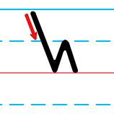
𐑿 – yew
few → 𐑓𐑿
knew → 𐑯𐑿
new → 𐑯𐑿, 𐑯𐑵
use (v.) → 𐑿𐑟
use (n.) → 𐑿𐑕
used → 𐑿𐑟𐑛
used to → 𐑿𐑕𐑑 𐑑
you → 𐑿

Slide 46
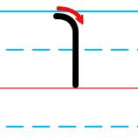
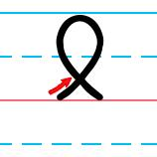
𐑐 – peep 𐑙 – hung
people → 𐑐𐑰𐑐𐑩𐑤
please → 𐑐𐑤𐑰𐑟
possible → 𐑐𐑪𐑕𐑩𐑚𐑩𐑤
up → 𐑳𐑐
during → 𐑛𐑘𐑫𐑮𐑦𐑙
long → 𐑤𐑪𐑙
wrong → 𐑮𐑪𐑙
young → 𐑘𐑳𐑙

Slide 47
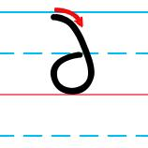
𐑔 – thigh
faithfully → 𐑓𐑱𐑔𐑓𐑩𐑤𐑦
nothing → 𐑯𐑳𐑔𐑦𐑙
something → 𐑕𐑳𐑥𐑔𐑦𐑙
thank → 𐑔𐑨𐑙𐑒
thing → 𐑔𐑦𐑙
think → 𐑔𐑦𐑙𐑒
three → 𐑔𐑮𐑰
through → 𐑔𐑮𐑵

Slide 48
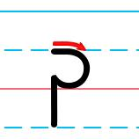
𐑜 – gag
again → 𐑩𐑜𐑱𐑯, 𐑩𐑜𐑧𐑯
against → 𐑩𐑜𐑱𐑯𐑕𐑑, 𐑩𐑜𐑧𐑯𐑕𐑑
give → 𐑜𐑦𐑝
go → 𐑜𐑴
good → 𐑜𐑫𐑛
got → 𐑜𐑪𐑑
great → 𐑜𐑮𐑱𐑑
together → 𐑑𐑩𐑜𐑧𐑞𐑼

Slide 49
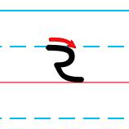
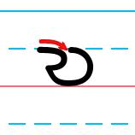
𐑷 – awe 𐑹 – or
all → 𐑷𐑤
also → 𐑷𐑤𐑕𐑴
although → 𐑷𐑤𐑞𐑴
always → 𐑷𐑤𐑢𐑱𐑟
talk → 𐑑𐑷𐑒
thought → 𐑔𐑷𐑑
before → 𐑚𐑦𐑓𐑹
for → 𐑓𐑹 [𐑓]
more → 𐑥𐑹
or → 𐑹
war 𐑢𐑹

Slide 50
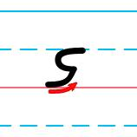
𐑭 – ah
after → 𐑭𐑓𐑑𐑼, 𐑨𐑓𐑑𐑼
can't → 𐑒𐑭𐑯𐑑
last → 𐑤𐑭𐑕𐑑, 𐑤𐑨𐑕𐑑
pass → 𐑐𐑭𐑕, 𐑐𐑨𐑕
past → 𐑐𐑭𐑕𐑑, 𐑐𐑨𐑕𐑑
rather → 𐑮𐑭𐑞𐑼

Slide 51
Review 1
𐑯 nun – 𐑯 (and)
𐑑 tot – 𐑑 (to)
𐑦 if – 𐑦𐑯 (in), 𐑦𐑑 (it)
𐑕 so
𐑤 loll – 𐑕𐑑𐑦𐑤 (still)
𐑛 dead – 𐑛𐑦𐑛 (did)
𐑢 woe – 𐑢𐑦𐑤 (will)
𐑥 mum – 𐑢𐑦𐑥𐑦𐑯 (women)

Slide 52
Review 2
𐑧 egg – 𐑥𐑧𐑯 (men), 𐑕𐑧𐑛 (said), 𐑢𐑧𐑤 (well)
𐑩 ado – 𐑩 (a), 𐑛𐑦𐑛𐑩𐑯𐑑 (didn’t), 𐑤𐑦𐑑𐑩𐑤 (little)
𐑳 up – 𐑛𐑳𐑯 (done), 𐑢𐑳𐑯 (one)
𐑒 kick – 𐑒𐑳𐑥 (come), 𐑯𐑧𐑒𐑕𐑑 (next)
𐑱 age – 𐑥𐑱𐑒 (make), 𐑑𐑩𐑛𐑱 (today)
𐑮 roar – 𐑮𐑦𐑑𐑩𐑯 (written)
𐑼 array – 𐑳𐑯𐑛𐑼 (under)
𐑽 ear – 𐑛𐑽 (dear), 𐑯𐑽 (near)

Slide 53
Review 3
𐑺 air – 𐑢𐑺 (where)
𐑻 err – 𐑢𐑻 (were), 𐑢𐑻𐑤𐑛 (world)
𐑞 they – 𐑳𐑞𐑼 (other), 𐑞𐑧𐑯 (then)
𐑟 zoo – 𐑛𐑳𐑟 (does), 𐑦𐑟 (is), 𐑕𐑧𐑟 (says)
𐑪 on – 𐑤𐑪𐑕𐑑 (lost), 𐑯𐑪𐑑 (not), 𐑢𐑪𐑟 (was)
𐑰 eat – 𐑥𐑰 (me), 𐑮𐑰𐑛 (read), 𐑞𐑰𐑟 (these)
𐑴 oak – 𐑛𐑴𐑯𐑑 (don’t), 𐑯𐑴 (know)
𐑨 ash – 𐑨𐑥 (am), 𐑒𐑨𐑯 (can), 𐑞𐑨𐑑 (that)

Slide 54
Review 4
𐑓 fee – 𐑦𐑯𐑳𐑓 (enough), 𐑓𐑻𐑕𐑑 (first)
𐑲 ice – 𐑤𐑲𐑒 (like), 𐑢𐑲𐑤 (while)
𐑣 ha-ha – 𐑣𐑨𐑟 (has), 𐑣𐑴𐑤 (whole)
𐑝 vow – 𐑧𐑝𐑼 (ever), 𐑣𐑨𐑝 (have)
𐑚 bib – 𐑚𐑰 (be), 𐑚𐑦𐑒𐑪𐑟 (because)
𐑫 wool – 𐑒𐑫𐑛 (could), 𐑤𐑫𐑒 (look)
𐑵 ooze – 𐑛𐑵 (do), 𐑣𐑵 (who)
𐑘 yea – 𐑘𐑽 (year), 𐑘𐑧𐑕𐑑𐑼𐑛𐑱 (yesterday)

Slide 55
Review 5
𐑿 yew – 𐑓𐑿 (few), 𐑓𐑻𐑕𐑑 (first)
𐑐 peep – 𐑐𐑰𐑐𐑩𐑤 (people), 𐑐𐑤𐑰𐑟 (please)
𐑙 hung – 𐑮𐑪𐑙 (wrong), 𐑘𐑳𐑙 (young)
𐑔 thigh – 𐑔𐑦𐑙𐑒 (think), 𐑔𐑮𐑵 (through)
𐑜 gag – 𐑜𐑦𐑝 (give), 𐑜𐑫𐑛 (good)
𐑷 awe – 𐑷𐑤𐑕𐑴 (also), 𐑑𐑷𐑒 (talk)
𐑹 or – 𐑥𐑹 (more), 𐑢𐑹 (war)
𐑭 ah – 𐑤𐑭𐑕𐑑 (last), 𐑐𐑭𐑕𐑑 (past)

Slide 56
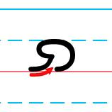
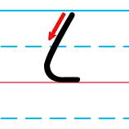
𐑸 – are 𐑖 – sure
are → 𐑸
far → 𐑓𐑸
part → 𐑐𐑸𐑑
shall → 𐑖𐑨𐑤
shan’t → 𐑖𐑭𐑯𐑑
she → 𐑖𐑰
should → 𐑖𐑫𐑛
sure → 𐑖𐑫𐑼

Slide 57

𐑗 – church
each → 𐑰𐑗
much → 𐑥𐑳𐑗
question → 𐑒𐑢𐑧𐑕𐑗𐑩𐑯
reach → 𐑮𐑰𐑗
such → 𐑕𐑳𐑗
which → 𐑢𐑦𐑗

Slide 58

𐑬 – out
about → 𐑩𐑚𐑬𐑑
down → 𐑛𐑬𐑯
how → 𐑣𐑬
now → 𐑯𐑬
our → 𐑬𐑼
out → 𐑬𐑑

Slide 59



𐑡 – judge 𐑠 – measaure 𐑶 – oil
just → 𐑡𐑳𐑕𐑑
large → 𐑤𐑸𐑡
pleasure → 𐑐𐑤𐑧𐑠𐑼
usual → 𐑿𐑠𐑫𐑩𐑤
oil → 𐑶𐑤

Slide 60
Review 1
𐑯 nun – 𐑯 (and)
𐑑 tot – 𐑑 (to)
𐑦 if – 𐑦𐑯 (in), 𐑦𐑑 (it)
𐑕 so
𐑤 loll – 𐑕𐑑𐑦𐑤 (still)
𐑛 dead – 𐑛𐑦𐑛 (did)
𐑢 woe – 𐑢𐑦𐑤 (will)
𐑥 mum – 𐑢𐑦𐑥𐑦𐑯 (women)

Slide 61
Review 2
𐑧 egg – 𐑥𐑧𐑯 (men), 𐑕𐑧𐑛 (said), 𐑢𐑧𐑤 (well)
𐑩 ado – 𐑩 (a), 𐑛𐑦𐑛𐑩𐑯𐑑 (didn’t), 𐑤𐑦𐑑𐑩𐑤 (little)
𐑳 up – 𐑛𐑳𐑯 (done), 𐑢𐑳𐑯 (one)
𐑒 kick – 𐑒𐑳𐑥 (come), 𐑯𐑧𐑒𐑕𐑑 (next)
𐑱 age – 𐑥𐑱𐑒 (make), 𐑑𐑩𐑛𐑱 (today)
𐑮 roar – 𐑮𐑦𐑑𐑩𐑯 (written)
𐑼 array – 𐑳𐑯𐑛𐑼 (under)
𐑽 ear – 𐑛𐑽 (dear), 𐑯𐑽 (near)

Slide 62
Review 3
𐑺 air – 𐑢𐑺 (where)
𐑻 err – 𐑢𐑻 (were), 𐑢𐑻𐑤𐑛 (world)
𐑞 they – 𐑳𐑞𐑼 (other), 𐑞𐑧𐑯 (then)
𐑟 zoo – 𐑛𐑳𐑟 (does), 𐑦𐑟 (is), 𐑕𐑧𐑟 (says)
𐑪 on – 𐑤𐑪𐑕𐑑 (lost), 𐑯𐑪𐑑 (not), 𐑢𐑪𐑟 (was)
𐑰 eat – 𐑥𐑰 (me), 𐑮𐑰𐑛 (read), 𐑞𐑰𐑟 (these)
𐑴 oak – 𐑛𐑴𐑯𐑑 (don’t), 𐑯𐑴 (know)
𐑨 ash – 𐑨𐑥 (am), 𐑒𐑨𐑯 (can), 𐑞𐑨𐑑 (that)

Slide 63
Review 4
𐑓 fee – 𐑦𐑯𐑳𐑓 (enough), 𐑓𐑻𐑕𐑑 (first)
𐑲 ice – 𐑤𐑲𐑒 (like), 𐑢𐑲𐑤 (while)
𐑣 ha-ha – 𐑣𐑨𐑟 (has), 𐑣𐑴𐑤 (whole)
𐑝 vow – 𐑧𐑝𐑼 (ever), 𐑣𐑨𐑝 (have)
𐑚 bib – 𐑚𐑰 (be), 𐑚𐑦𐑒𐑪𐑟 (because)
𐑫 wool – 𐑒𐑫𐑛 (could), 𐑤𐑫𐑒 (look)
𐑵 ooze – 𐑛𐑵 (do), 𐑣𐑵 (who)
𐑘 yea – 𐑘𐑽 (year), 𐑘𐑧𐑕𐑑𐑼𐑛𐑱 (yesterday)

Slide 64
Review 5
𐑿 yew – 𐑓𐑿 (few), 𐑓𐑻𐑕𐑑 (first)
𐑐 peep – 𐑐𐑰𐑐𐑩𐑤 (people), 𐑐𐑤𐑰𐑟 (please)
𐑙 hung – 𐑮𐑪𐑙 (wrong), 𐑘𐑳𐑙 (young)
𐑔 thigh – 𐑔𐑦𐑙𐑒 (think), 𐑔𐑮𐑵 (through)
𐑜 gag – 𐑜𐑦𐑝 (give), 𐑜𐑫𐑛 (good)
𐑷 awe – 𐑷𐑤𐑕𐑴 (also), 𐑑𐑷𐑒 (talk)
𐑹 or – 𐑥𐑹 (more), 𐑢𐑹 (war)
𐑭 ah – 𐑤𐑭𐑕𐑑 (last), 𐑐𐑭𐑕𐑑 (past)

Slide 65
Review 6
𐑸 are – 𐑓𐑸 (far), 𐑐𐑸𐑑 (part)
𐑖 sure – 𐑖𐑰 (she), 𐑖𐑫𐑛 (should)
𐑗 church – 𐑰𐑗 (each), 𐑢𐑦𐑗 (which)
𐑬 out – 𐑩𐑚𐑬𐑑 (about), 𐑯𐑬 (now)
𐑡 judge – 𐑡𐑳𐑕𐑑 (just), 𐑤𐑸𐑡 (large)
𐑠 measure –
𐑐𐑤𐑧𐑠𐑼 (pleasure), usual (𐑿𐑠𐑫𐑩𐑤)
𐑶 oil – 𐑶𐑤 (oil)

Slide 66
𐑦 – if “happY tensing”
already→ 𐑷𐑤𐑮𐑧𐑛𐑦
any → 𐑧𐑯𐑦
every → 𐑧𐑝𐑮𐑦
many → 𐑥𐑧𐑯𐑦
money → 𐑥𐑳𐑯𐑦
only → 𐑴𐑯𐑤𐑦
sincerely → 𐑕𐑦𐑯𐑕𐑽𐑤𐑦
truly → 𐑑𐑮𐑵𐑤𐑦
vary → 𐑝𐑺𐑦
very → 𐑝𐑧𐑮𐑦

Slide 67

𐑾 – Ian
really → 𐑮𐑾𐑤𐑦
cordially → 𐑒𐑹𐑛𐑾𐑤𐑦
Shavian → ·𐑖𐑱𐑝𐑾𐑯

Slide 68


Final Review

Slide 69
The Alphabet 𐑞 𐑨𐑤𐑓𐑩𐑚𐑧𐑑
𐑐 𐑚 𐑑 𐑛 𐑒 𐑜 𐑓 𐑝 𐑔 𐑞 𐑕 𐑟 𐑖 𐑠 𐑗 𐑡 𐑘 𐑢 𐑙 𐑣
𐑤 𐑮 𐑥 𐑯 𐑦 𐑰 𐑧 𐑱 𐑨 𐑲 𐑩 𐑳 𐑪 𐑴 𐑫 𐑵 𐑬 𐑶 𐑭 𐑷
𐑸 𐑹 𐑺 𐑻 𐑼 𐑽 𐑾 𐑿

Slide 70

Alphabetical Order 𐑨𐑤𐑓𐑩𐑚𐑧𐑑𐑦𐑒𐑩𐑤 𐑹𐑛𐑼
Replace clip art with drawings.

Slide 71

The Alphabet 𐑞 𐑨𐑤𐑓𐑩𐑚𐑧𐑑

Slide 72
International Phenetic Alphabet (IPA)
p b t d k ɡ f v θ ð s z ʃ ʒ ʧ ʤ j w ŋ h l r m n ɪ/i iː ɛ eɪ æ aɪ ə ʌ ɒ əʊ ʊ/u uː aʊ ɔɪ ɑː ɔː
/ɑː(r)/ /ɔː(r)/ /ɛə(r)/ /ɜː(r)/ /ə(r)/ /ɪə(r)/ /ɪə/ /juː/

